Slide 1
11.9 Bagging Cross-Validated Models

Slide 2
The random nature of splitting data into training and validation poses a potential flaw to our cross-validation process: bad training-validation splits.
Such bad splits are not desirable representatives of the underlying phenomenon that generated them, which can result in poorly representative cross-validated models.

Slide 3
A practical solution to this fundamental problem is to simply perform several different training-validation splits, determine an appropriate cross-validated model on each split, and then *average* the resulting cross-validated models. This is called bagging.
By averaging a set of cross-validated models we can *very often* both 'average out' the potentially undesirable characteristics of each model while synergizing their positive attributes.

Slide 4
Bagging regression models

Slide 5
Generally the best way to bag (or average) cross-validated regression models is by taking their median (as opposed to their mean).

Slide 6
Example: Bagging cross-validated regression models

Slide 7
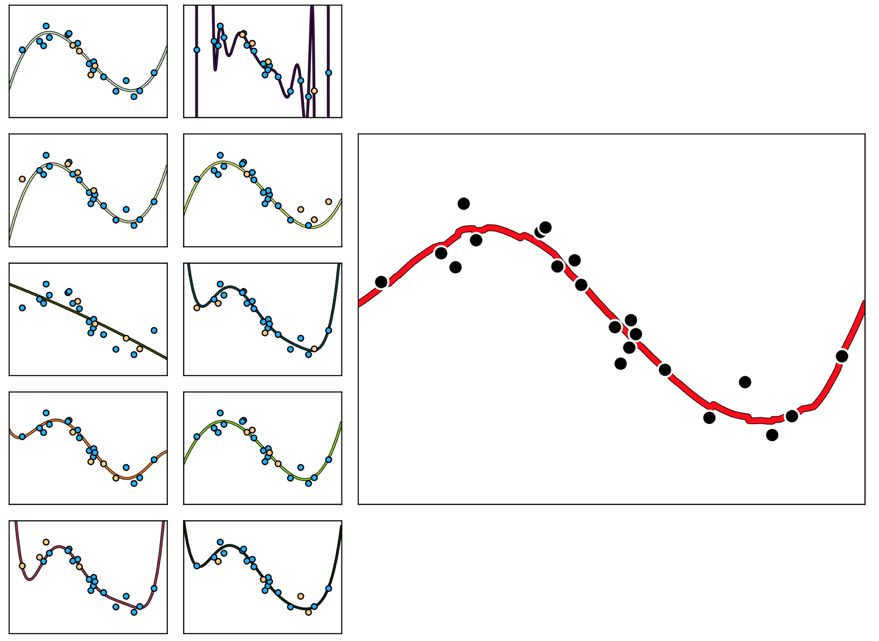
(small panels) Ten different random training-validation splits of a nonlinear regression dataset (blue: training, yellow: validation), with the best cross-validated model drawn in each panel.
(large panel) The bagged (median) model of the 10 models whose fits are shown on the left.

Slide 8
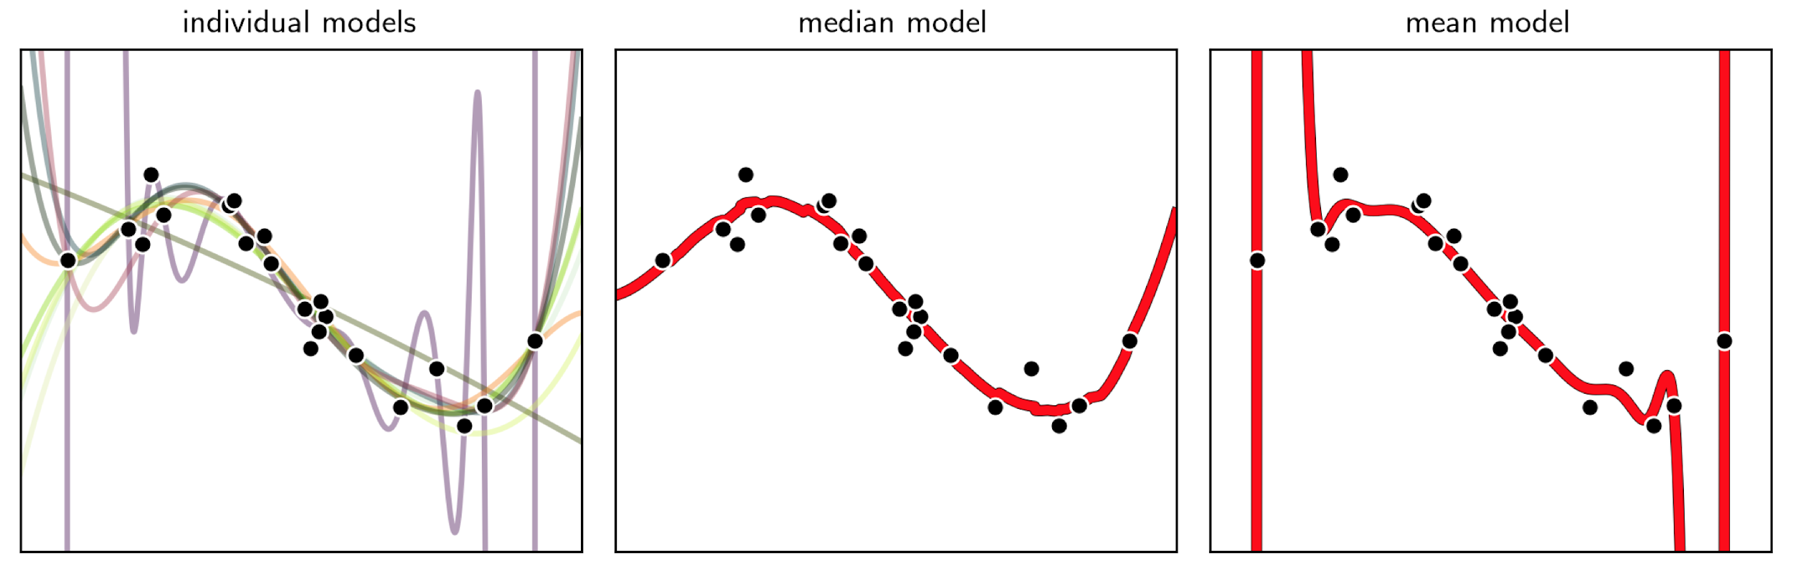
Why the median, not the mean?
Because generally speaking, the mean is more sensitive to *outliers* the median.

Slide 9
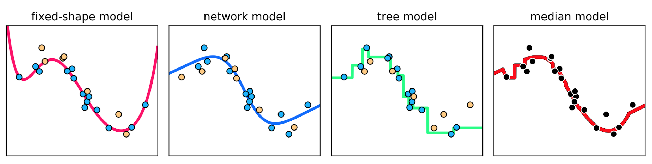
Bagging polynomials, neural networks, and trees together
With bagging we can also effectively combine cross-validated models built from different universal approximators.

Slide 10
Bagging classification models

Slide 11
Because the predicted output of a classification model is a *discrete* label, the average used to bag such cross-validated models is the mode (i.e., themost popularly predicted label).

Slide 12
Example: Bagging cross-validated two-class classification models

Slide 13
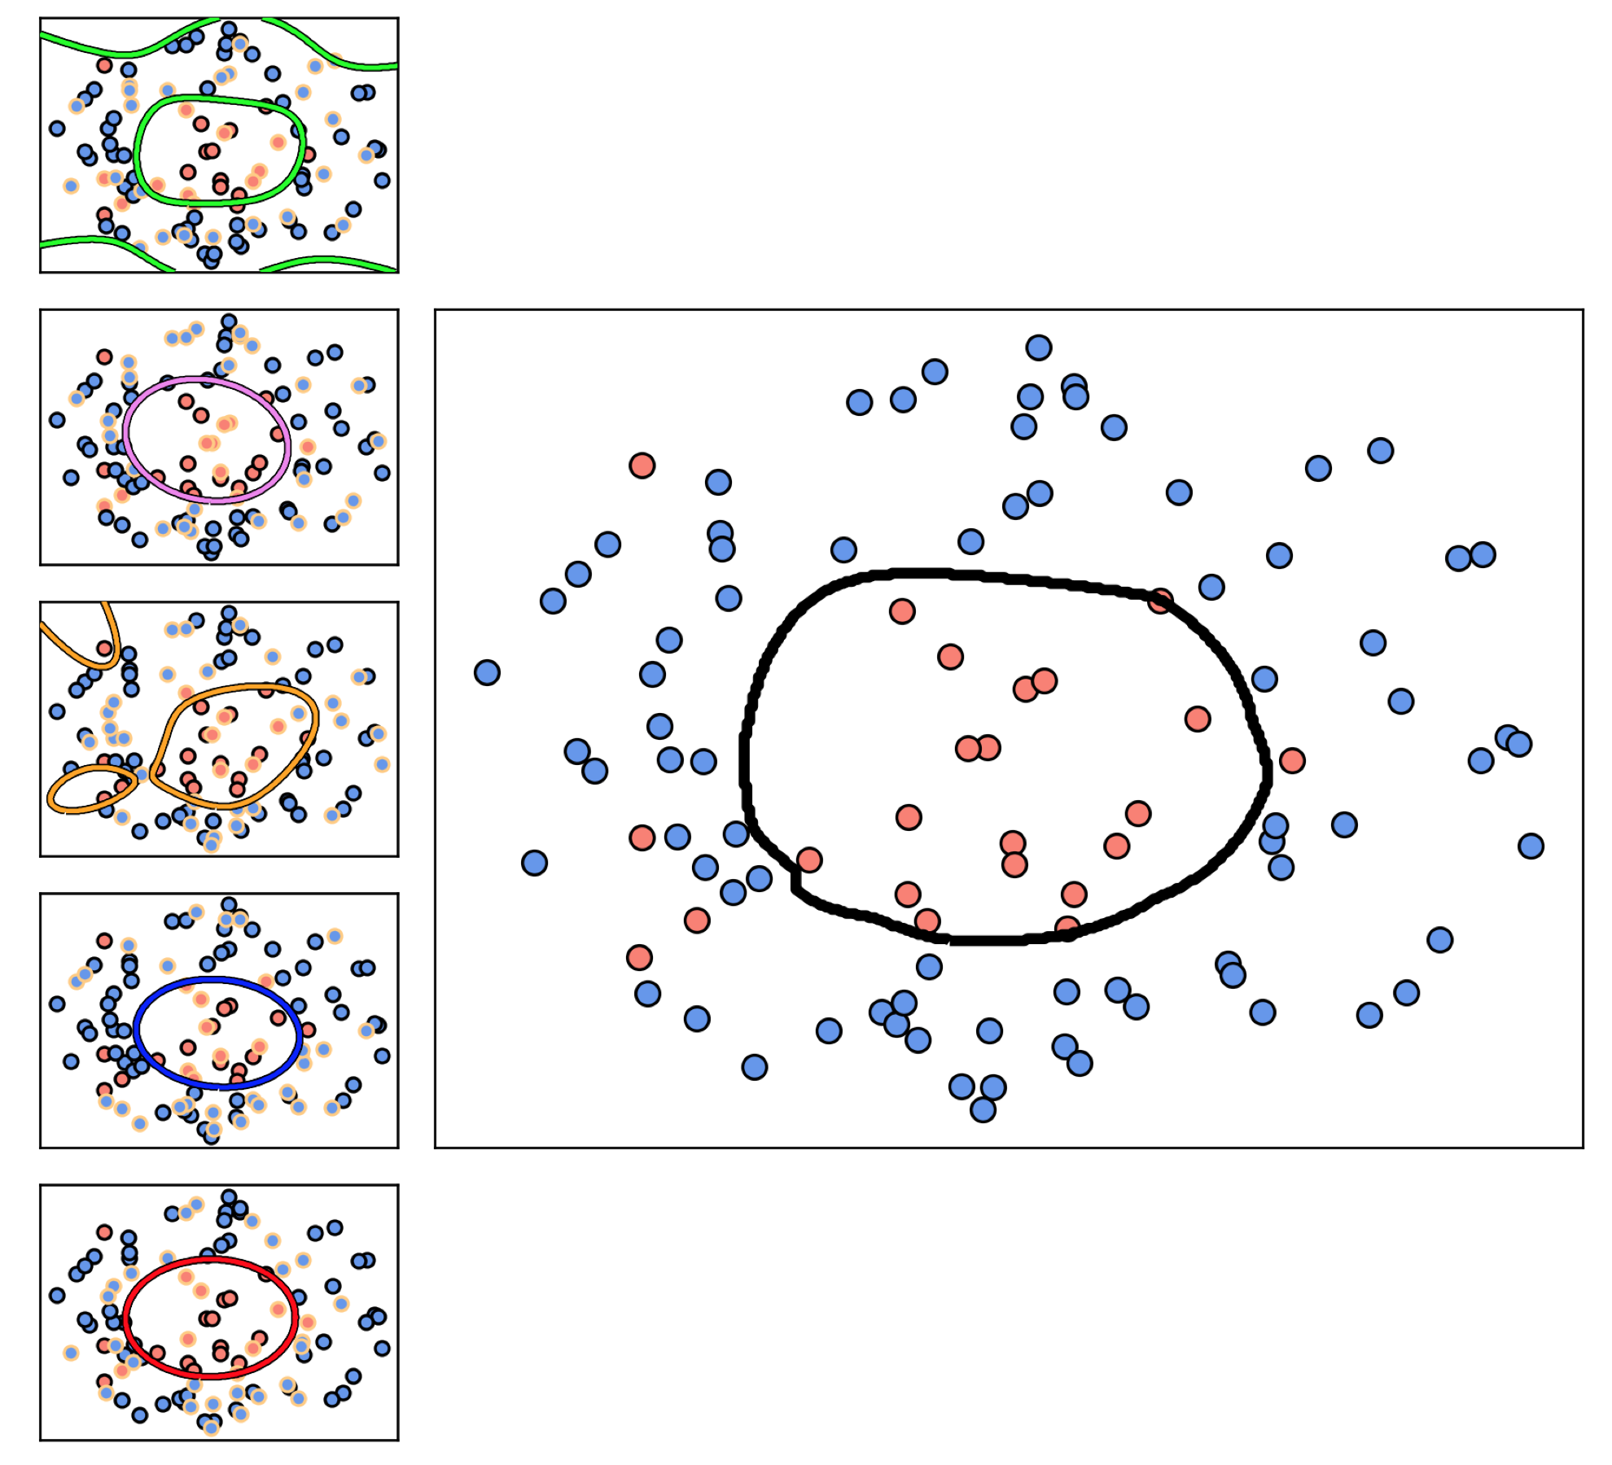
(small panels) Five models cross-validated on random training-validation splits of the data, with the validation data in each instance highlighted with a yellow outline.
(large panel) The bagged (modal) model of the 5 models shown on the left.

Slide 14
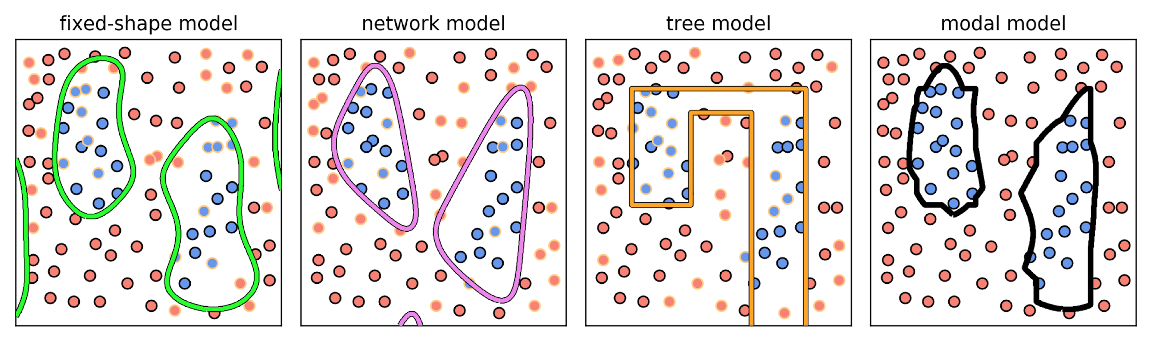
Bagging different types of universal approximators
As with regression, with classification we can also combine cross-validated models built from different universal approximators.

Slide 15
Bagging multi-class models

Slide 16
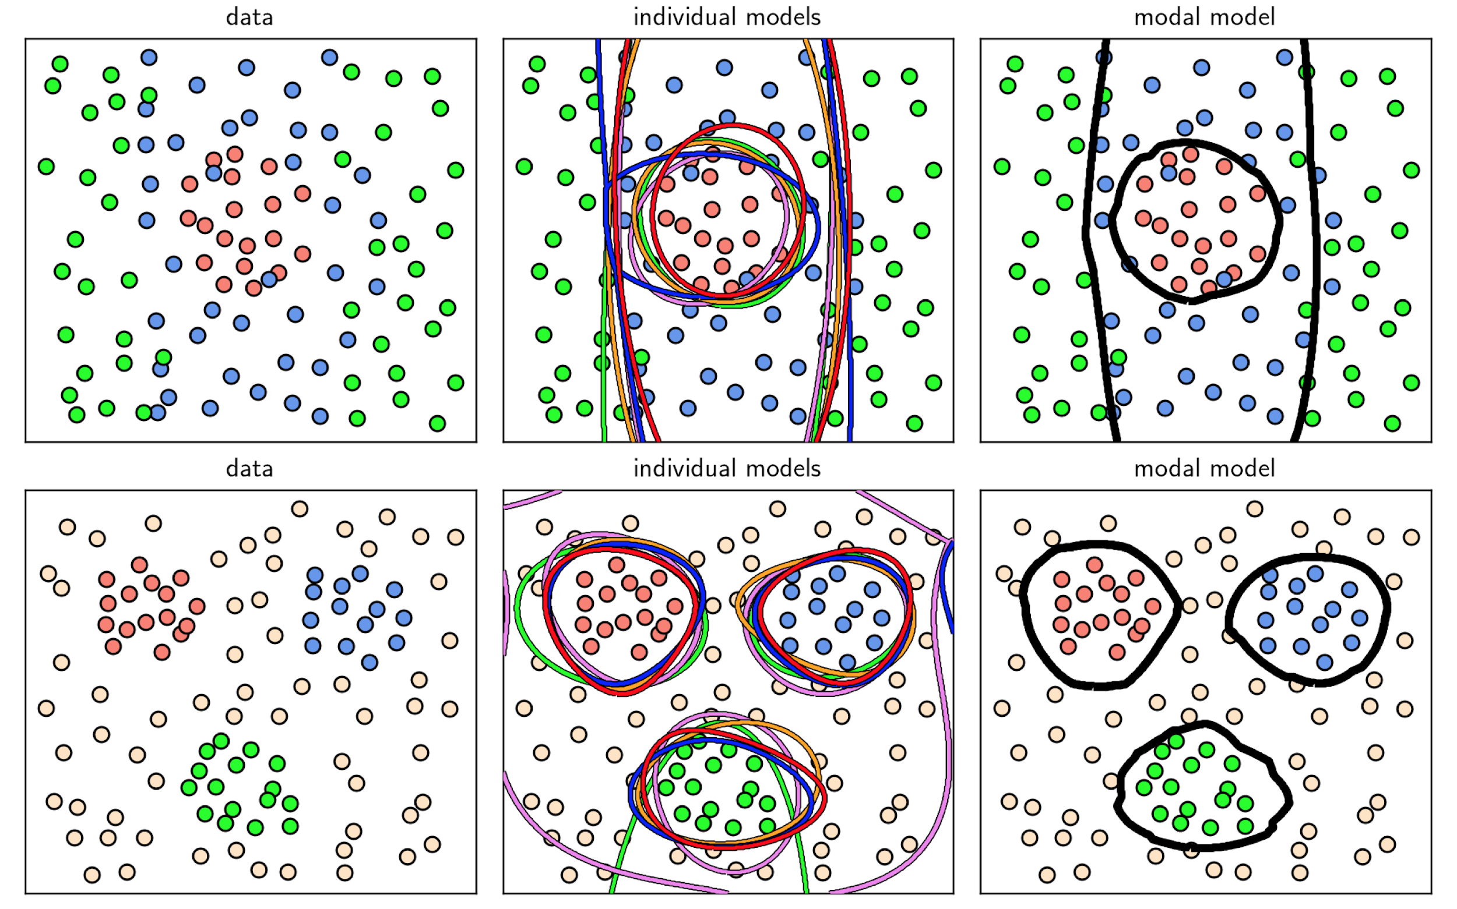

Slide 17
How many models should we bag in practice?

Slide 18
There is general no magic number.
The smaller the dataset, the less we could trust in the faithfulness of a random validation portion of it to represent the underlying phenomenon that generated the data, and hence we might wish to ensemble more of them to help average our poorly performing models resulting from bad splits of the data.
Usually practical considerations like computation power as well as dataset size determine if bagging is used and if so how many models are employed in the average.

Slide 19
Bagging vs. Boosting

Slide 20
Bagging and boosting are both "ensembling" methods, as they are used to ensemble or combine different models to improve efficacy.
With boosting we build up a single cross-validated model by gradually adding together simple models consisting of a single universal approximator unit. Each of these units are trained in a way that makes each individual model dependent on its predecessors (that are trained first).
With bagging we average together multiple models that have been trained independently of each other. Indeed any one of those cross-validated models in a bagged ensemble can itself be a boosted model.

